Slide 1
Bigfeet, Ufos, Ghosts!
(Oh my!)
Your Statistical Travel guide to Paranormal Experiences.
By Sean Malley
Nashville software School da10

Slide 2

Agenda
Introduction
Methods
Findings
Travel Packages (Conclusions)

Slide 3
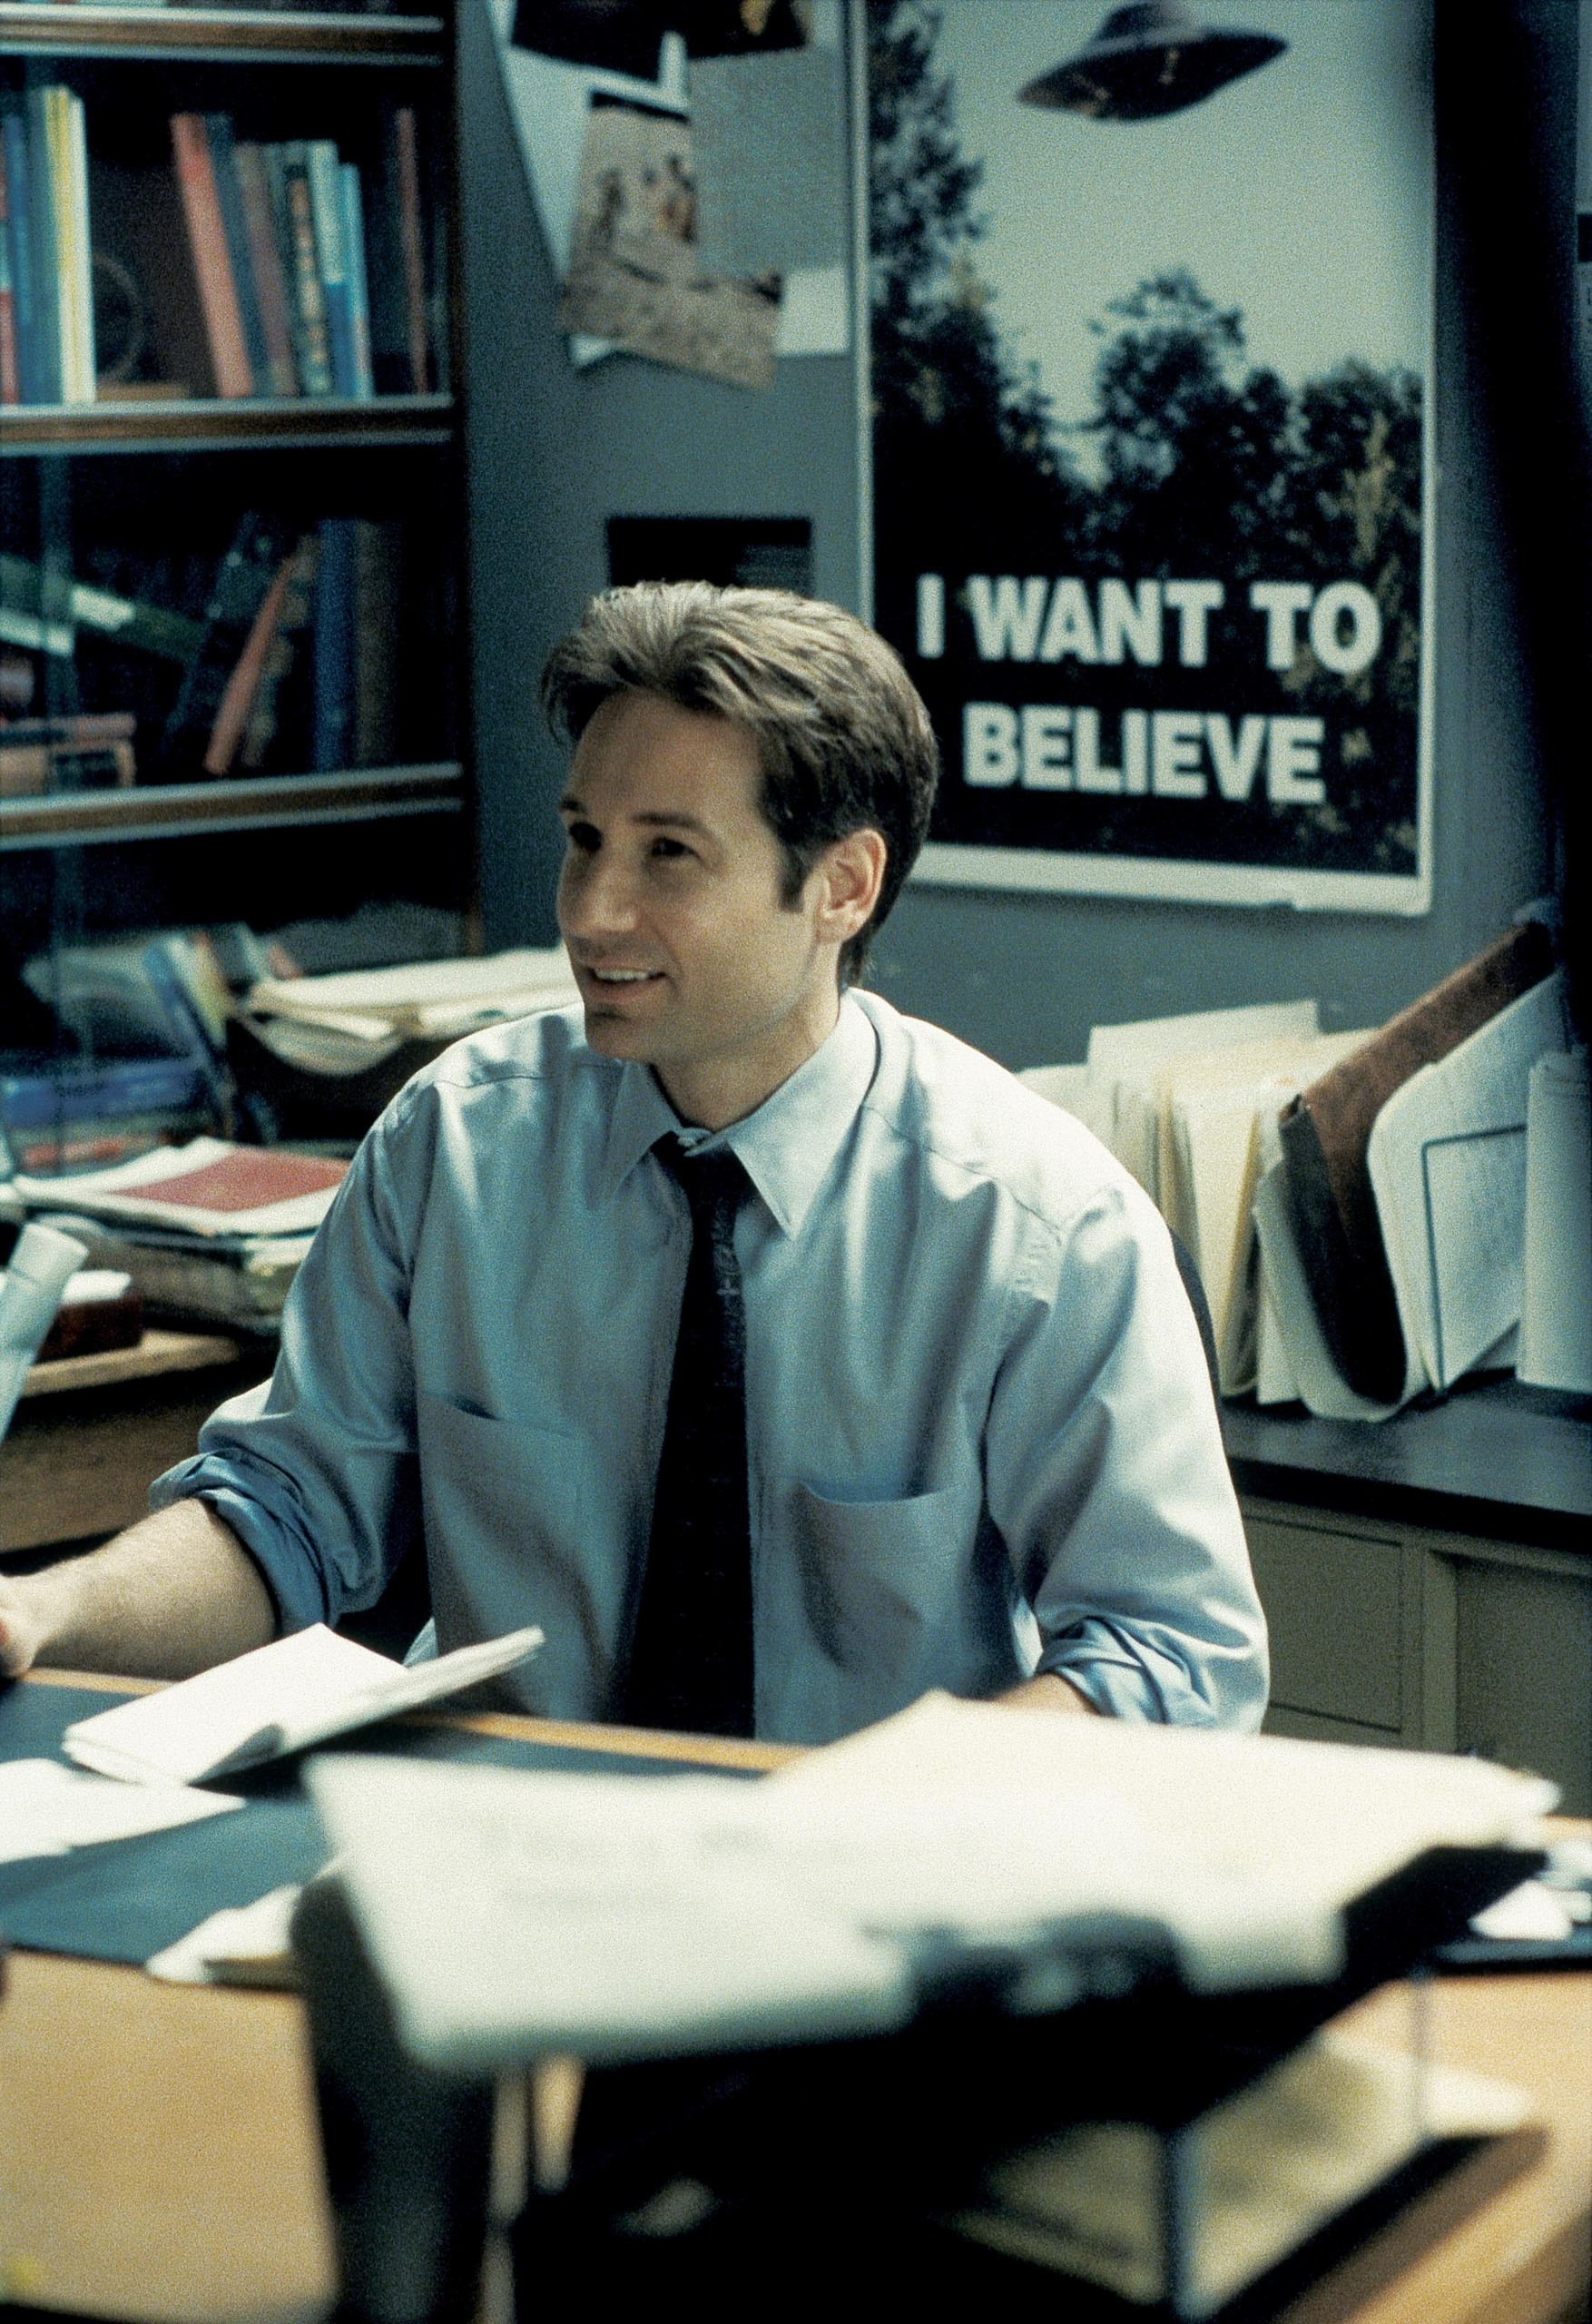
Introduction
People’s paranormal experiences have always fascinated me, and I was curious as to the universality of such experiences. Especially with the popularity of Bigfoot, Ghost and UFO hunting shows, I wanted to examine how sightings may have changed over time, and the kind of geographic distribution that such sightings have.
Given this data, I wanted to create a guide for those who may want to explore the unknown themselves.

Slide 4

Data sources
These data are pulled from the following 3 databases.
NUFORC UFO Sighting collection.
BigFoot Research Organization (BFRO) experience report repository.
Shadowlands.net Haunted Places collection, the original and largest online collection of ghost encouters since 1994.

Slide 5


Your Travel guide to
Paranormal
Experiences
You may hitchhike
if you like

Slide 6

Join us on a Journey into the unknown We will be examining the distribution of sightings for the following types of Paranormal Experiences
Bigfeet
UFOs
Hauntings

Slide 7
Methods
Data were collected from the following organizations in the form of csv files.
Bigfoot Research organization Sighting Database
Nuforc Ufo sighting Database
The Shadowlands online Haunting repository Data was cleaned and aggregated using python and excel with graphics primarily generated by Tableau.

Slide 8
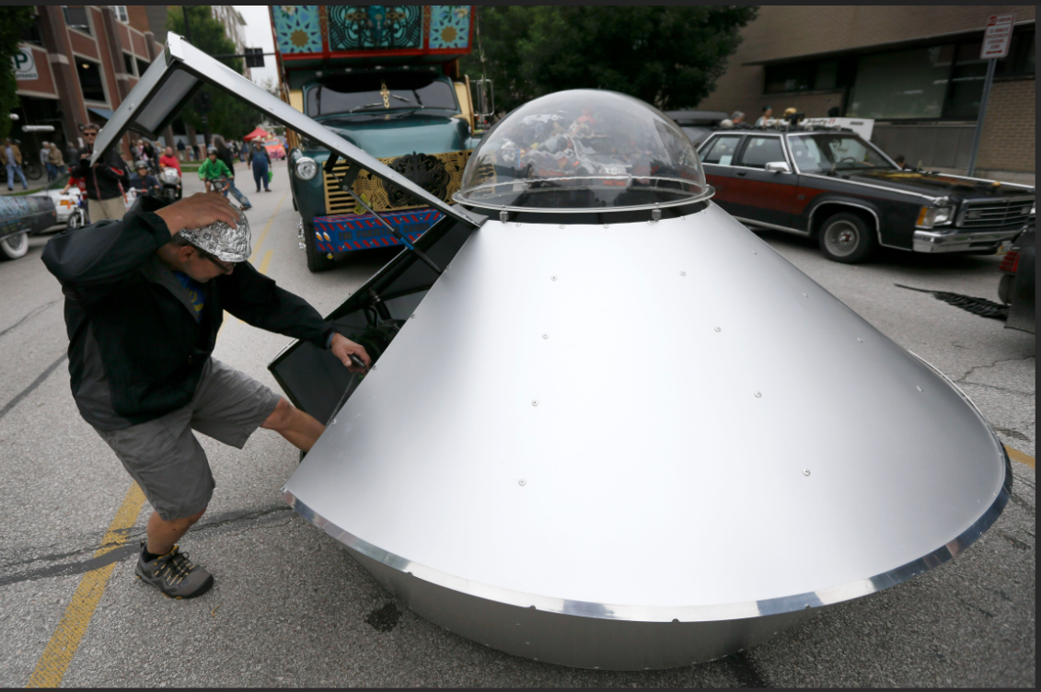
That’s a lot of swamp gas! Ufo sightings and incidence in the US

Slide 9
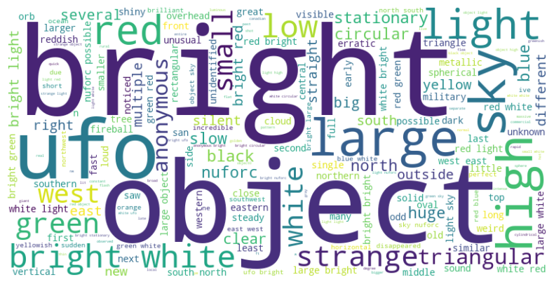
What are people saying about ufos?
These are the most common adjectives and descriptive words occurring the in the descriptions UFO experiences in the NUFORC database. Standard parts of speech have been omitted.

Slide 10
Top ufo destination cities in the top 5 states by total sightings.
1 ) California – 15,454
Los Angeles
San Diego
Sacramento
2) Florida – 7,823
Orlando - 384
Miami - 359
Jacksonville - 266
3) Washington - 6,896
Seattle - 780
Spokane - 249
Vancouver - 266
4) Texas – 5,816
Houston - 439
Austin - 345
San Antonio - 273
5) New York – 5,624
New York - 868
Buffalo - 143
Rochester - 143

Slide 11
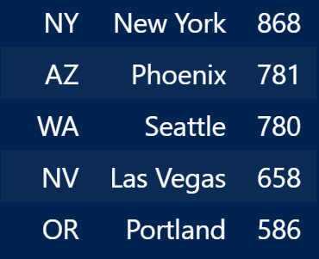
Top cities by UFO sightings, regardless of state rank.
It’s important to note that although many states have greater total sightings, many individual cities have high incidence rates of sightings.

Slide 12
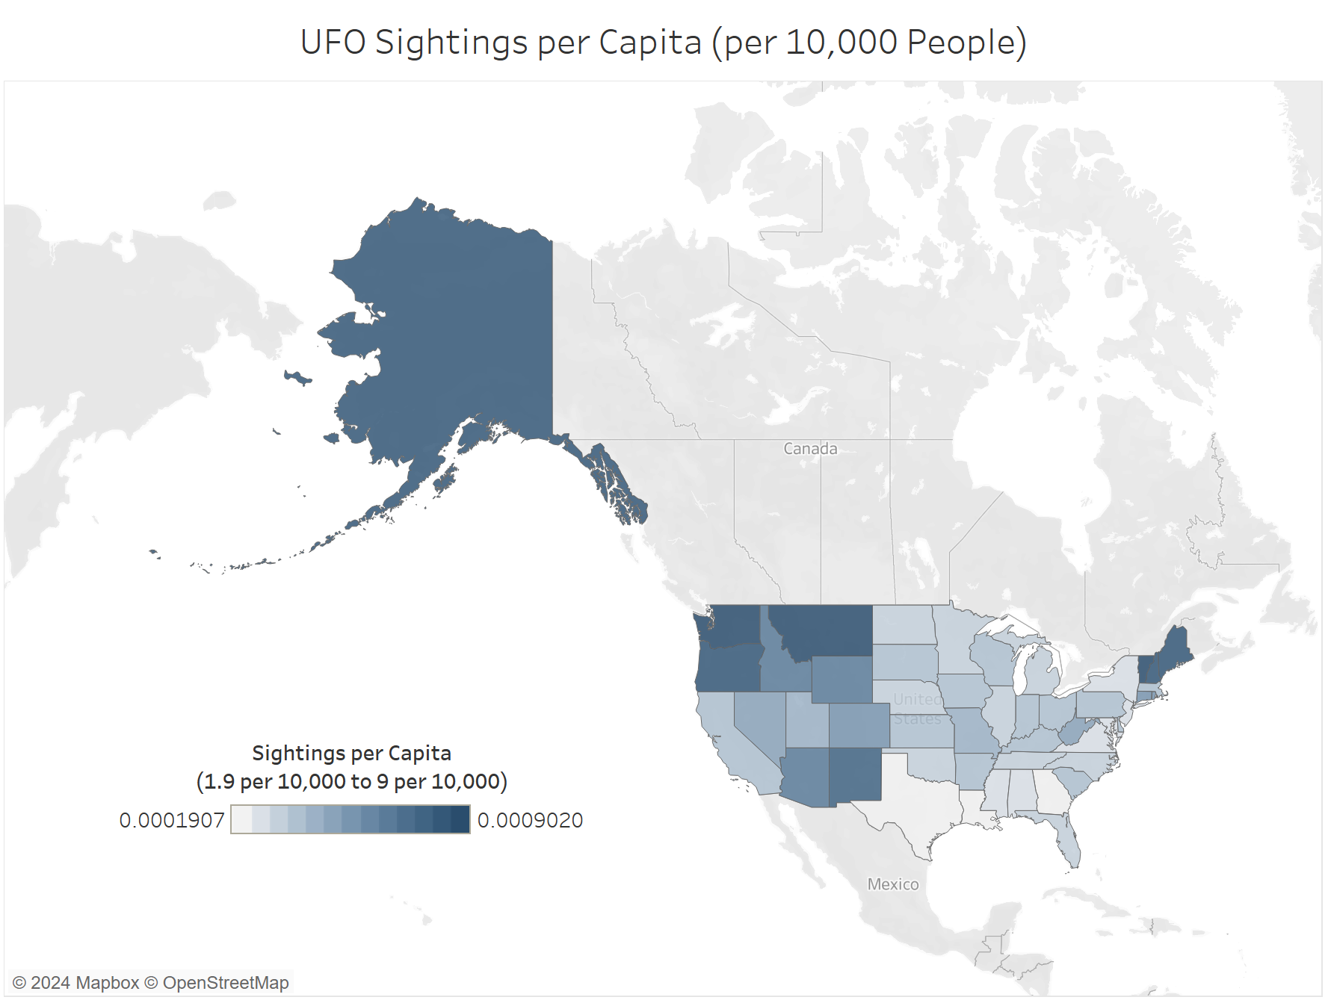
UFO sightings Per million (Per capita) Save some for me!

Slide 13
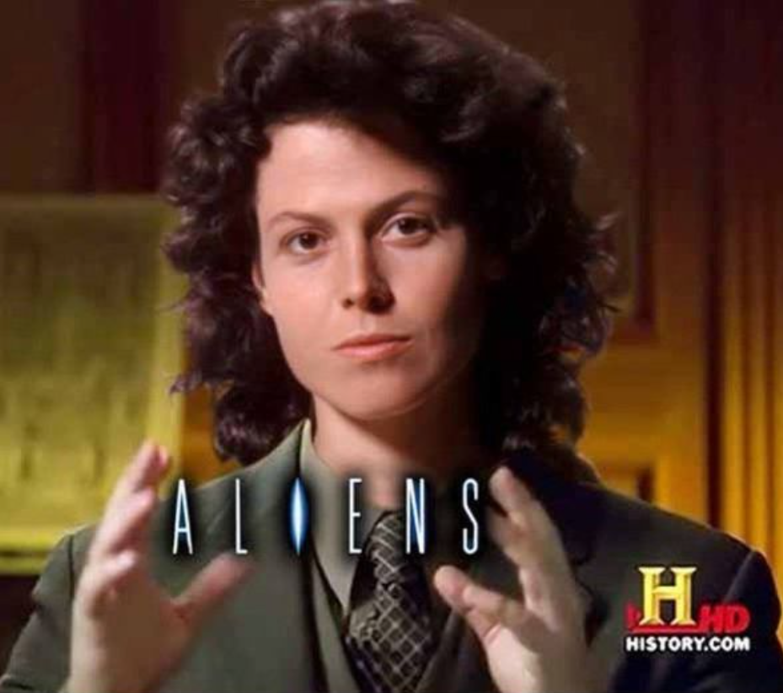
Ufo Sightings by State, by Year
Where/When can I find them saucers?

Slide 14
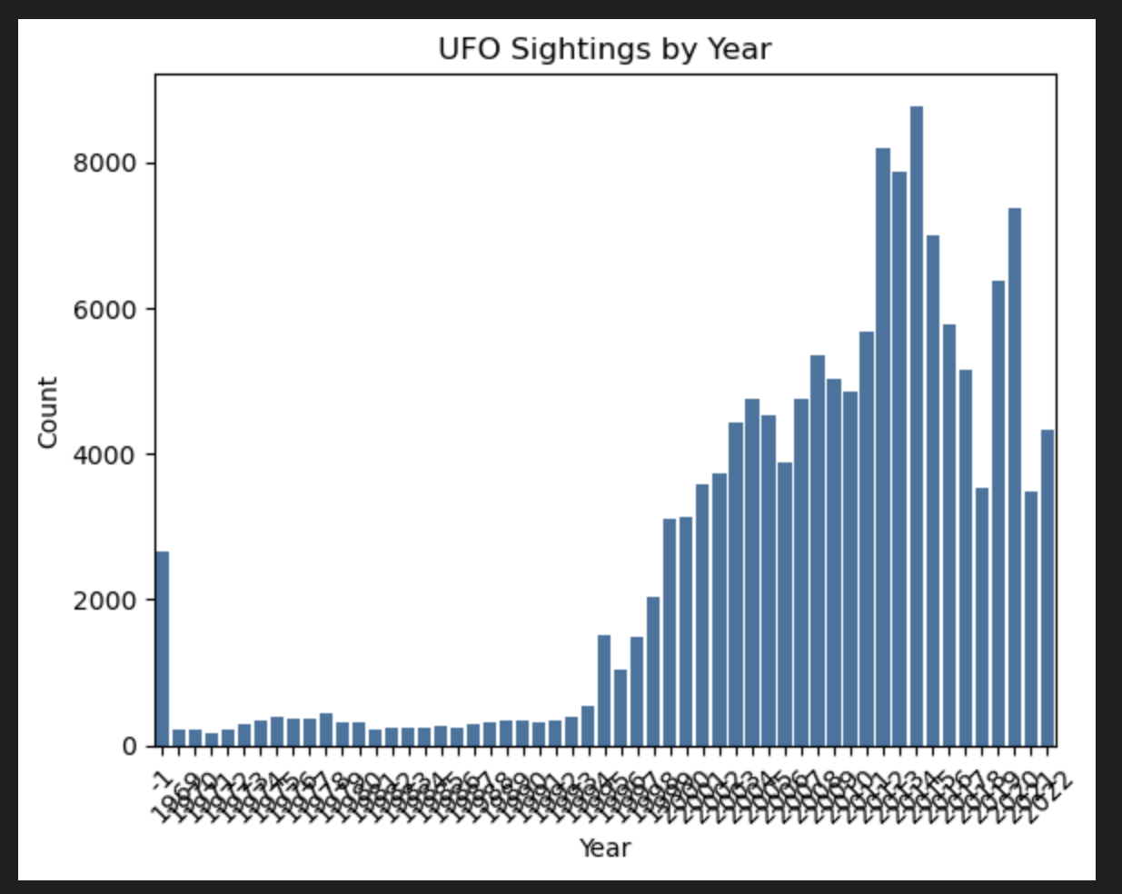
Ufo sightings by year
Don’t freak. I lost the file I had made, this will be replaced by a better one.

Slide 15
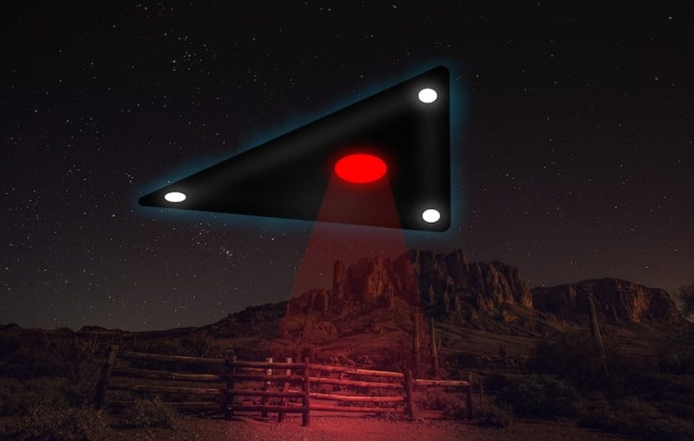
Most common shape of crafts observed
Lights - 28,505
Circle – 15,083
Triangles – 12,607
Fireballs – 9,678
Total sightings reported: 141,284

Slide 16

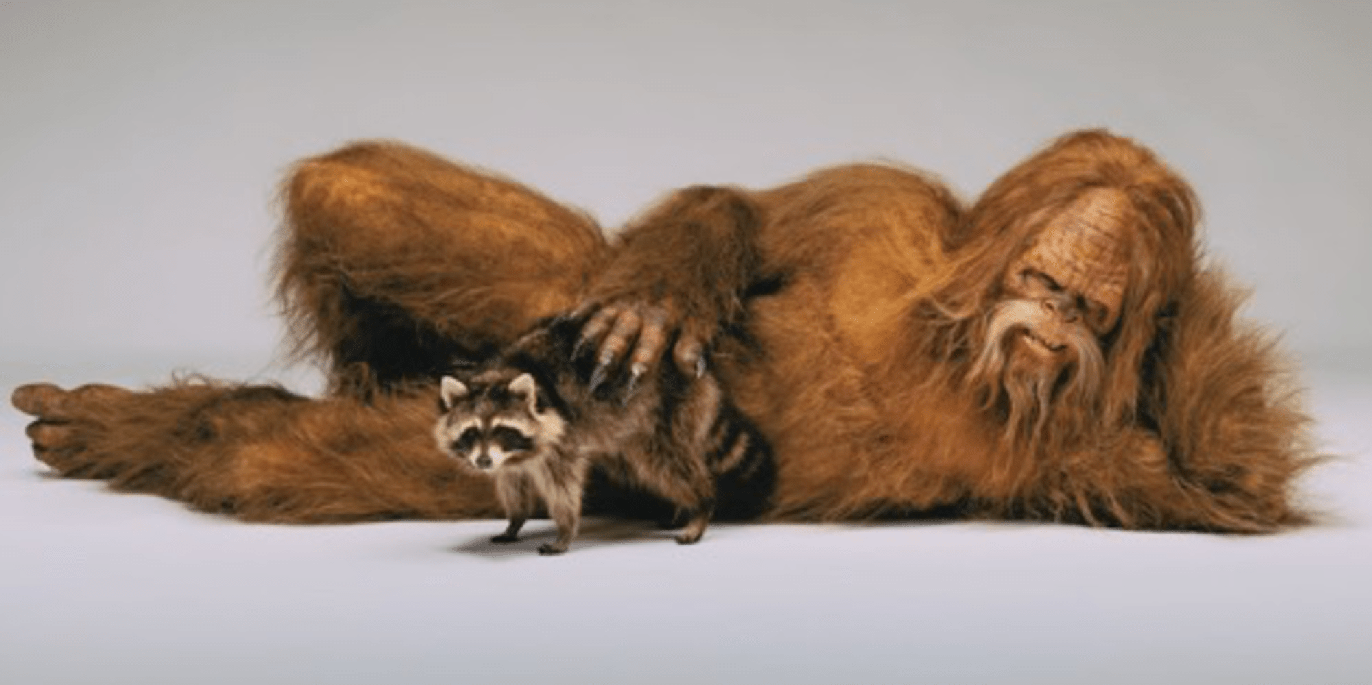
Bigfeet Is that a raccoon in your arms or are you just happy to see me?
Little known fact, the plural of Bigfoot is Bigfeet.
He’s not just a Northwestern Phenomenon!
Although the famous Bigfoot video was released in the 70s, this type of sighting has been reported since records have been kept.
Total sightings reported: 5,044

Slide 17
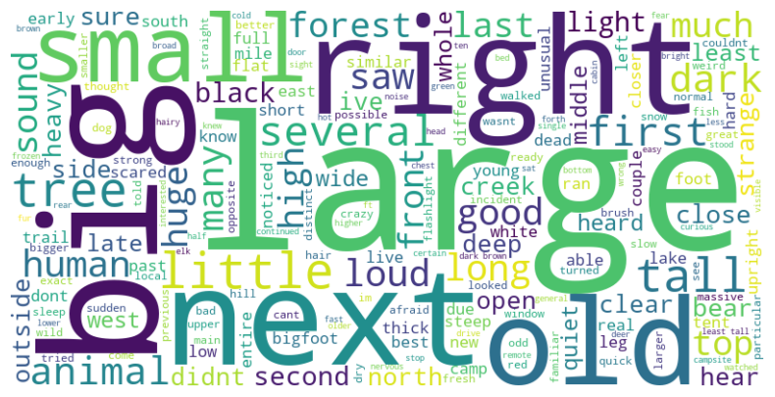
What are people saying about bigfoot?
These are the most common adjectives and descriptive words occurring the in the descriptions of the sightings reported in the BFRO database.
Standard parts of speech have been omitted.

Slide 18
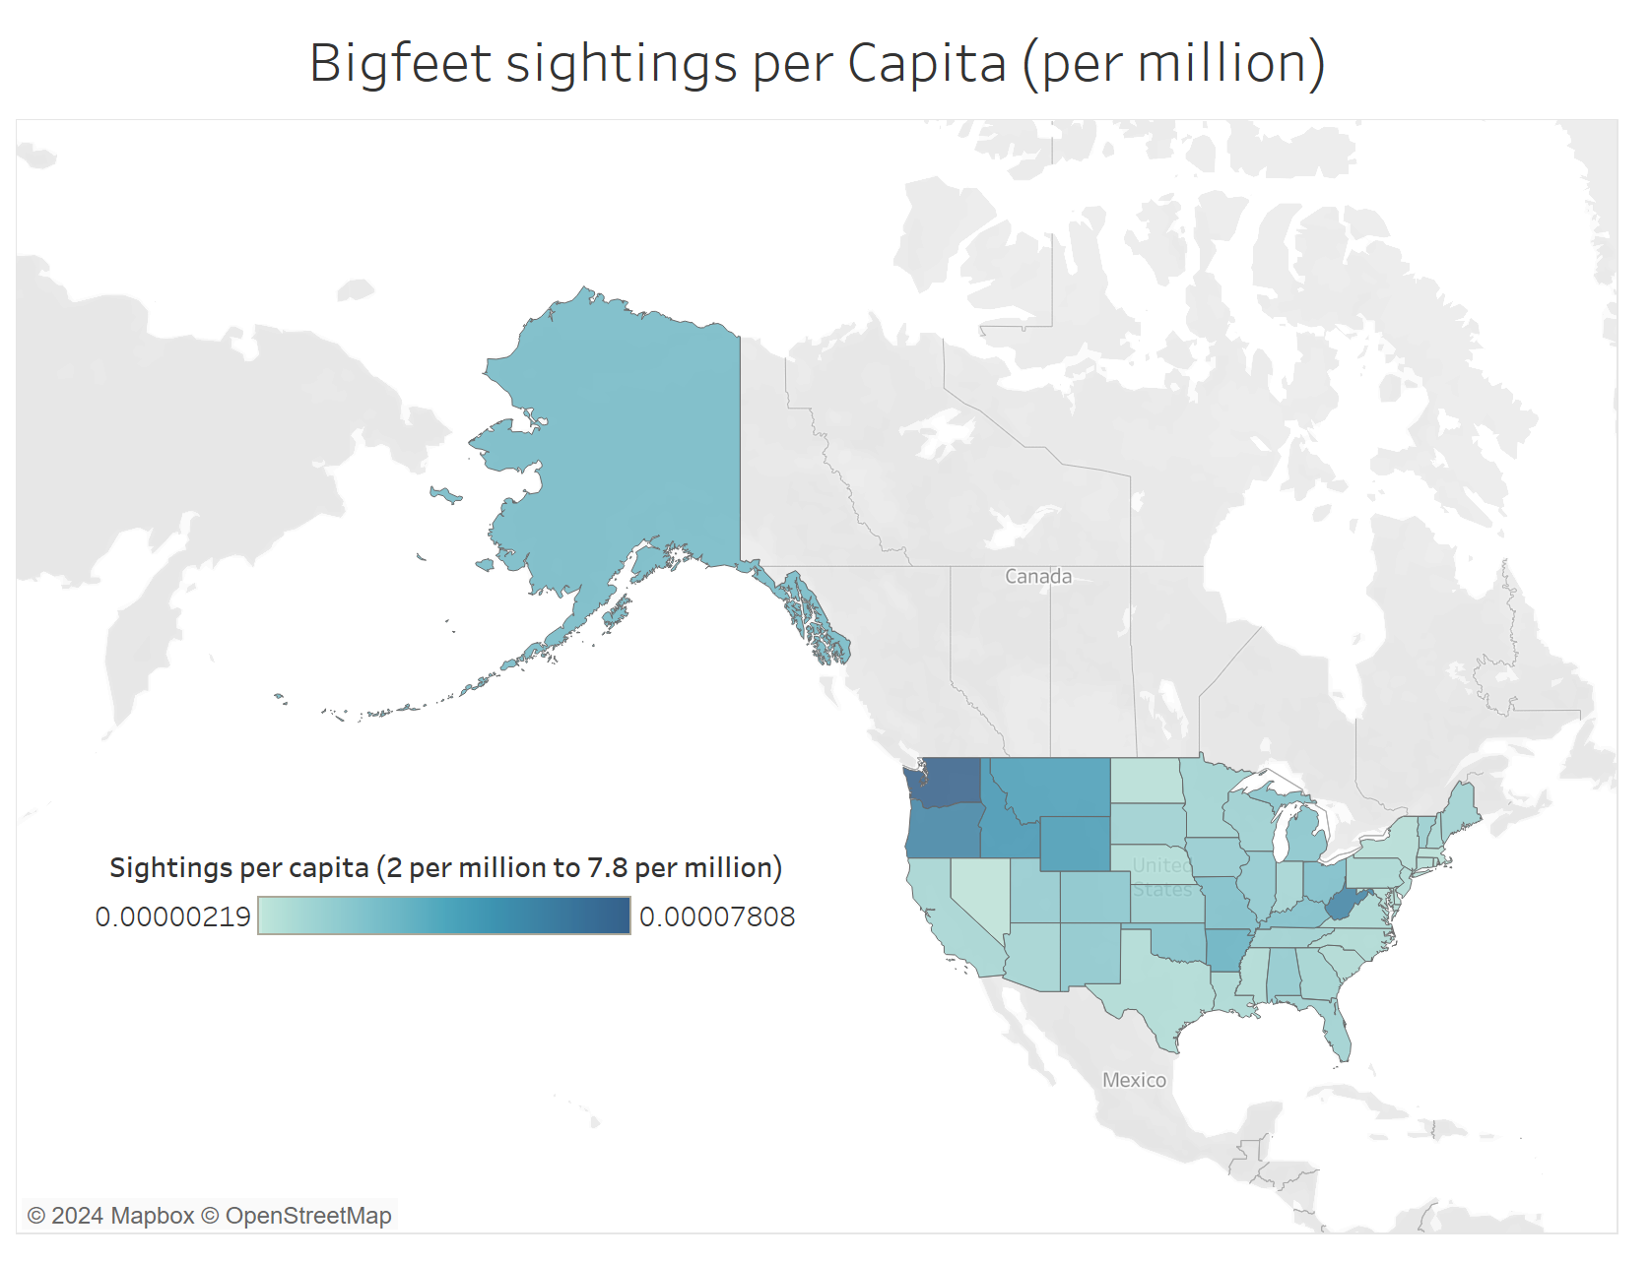
Bigfeet sightings per Capita
Sightings per million people, from 2.19 sightings per million people to 7.8 per million people.

Slide 19
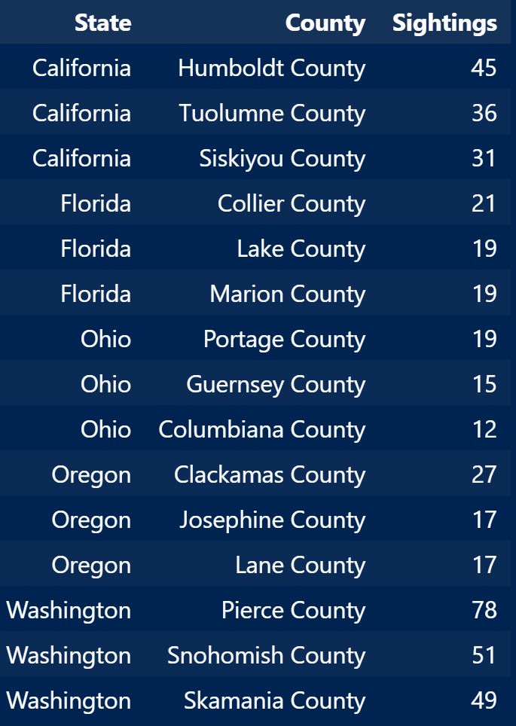
Top States and counties to find a bigfoot
Top 3 counties by state to have a bigfoot encounter.

Slide 20
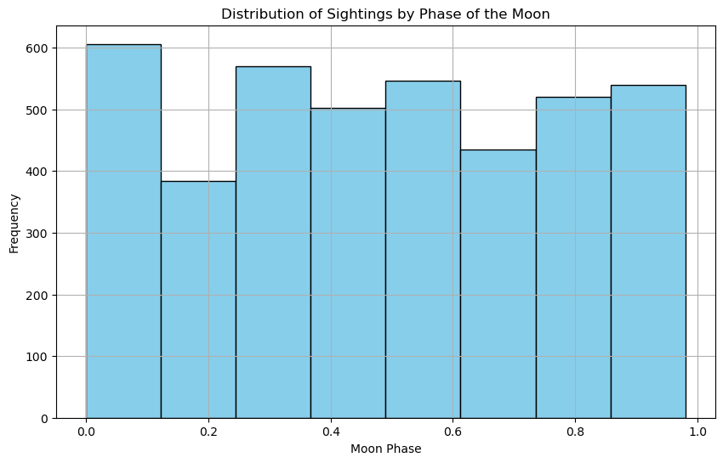
Could Bigfoot be a Werewolf?
There seems to be a correlation between sightings and the phase of the moon, specifically each quarter moon.
This may be explained by users estimating what the moon phase was by the nearest quarter, though this is just a theory.
This data does not seem to suggest that bigfoot is a werewolf, unfortunately.

Slide 21
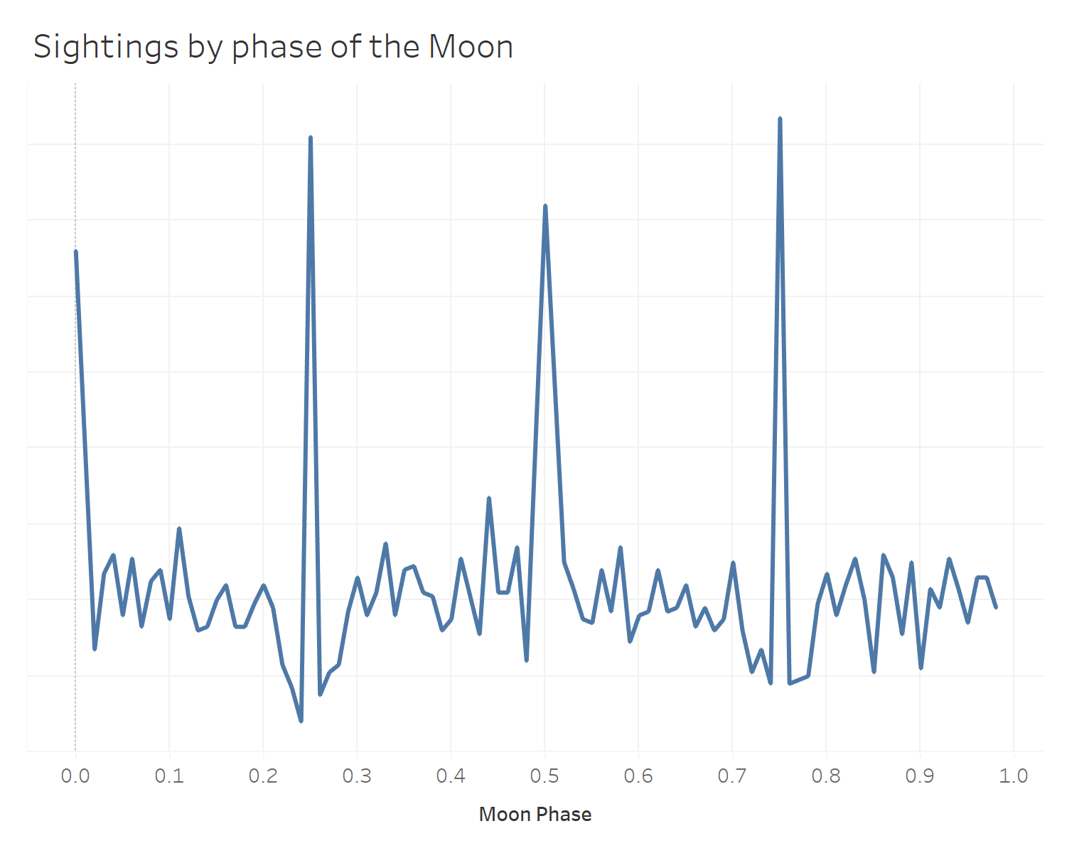
Could Bigfoot be a Werewolf?
This graph shows in more detail the instances of sightings by the phase of the moon. Note the spikes where the quarter moons would be occurring.

Slide 22
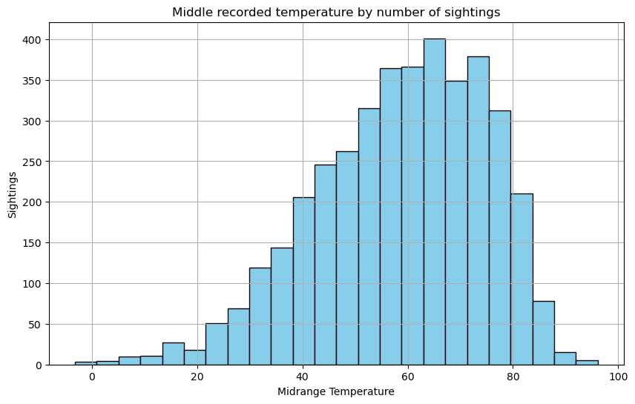
Is he a shorts in winter type of guy?
There appears to be a fairly normal distribution of sightings compared to the mid temperature recorded by NOAA for each date of the sightings.

Slide 23
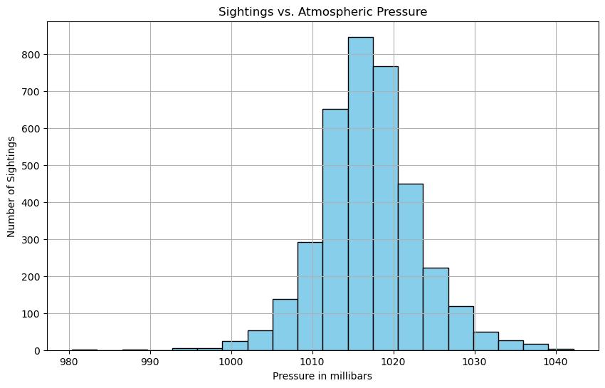
Could Bigfoot be a Weather Phenomenon?
The standard barometric pressure at sea level is 29.92 inches (1,013 millibars) of mercury (also measured as 1 atmosphere). In general, a normal range for barometric pressure is between 965 millibars) and 1,040 millibars of mercury. This would seem to indicate that these sightings are within a normal distribution of pressures.

Slide 24
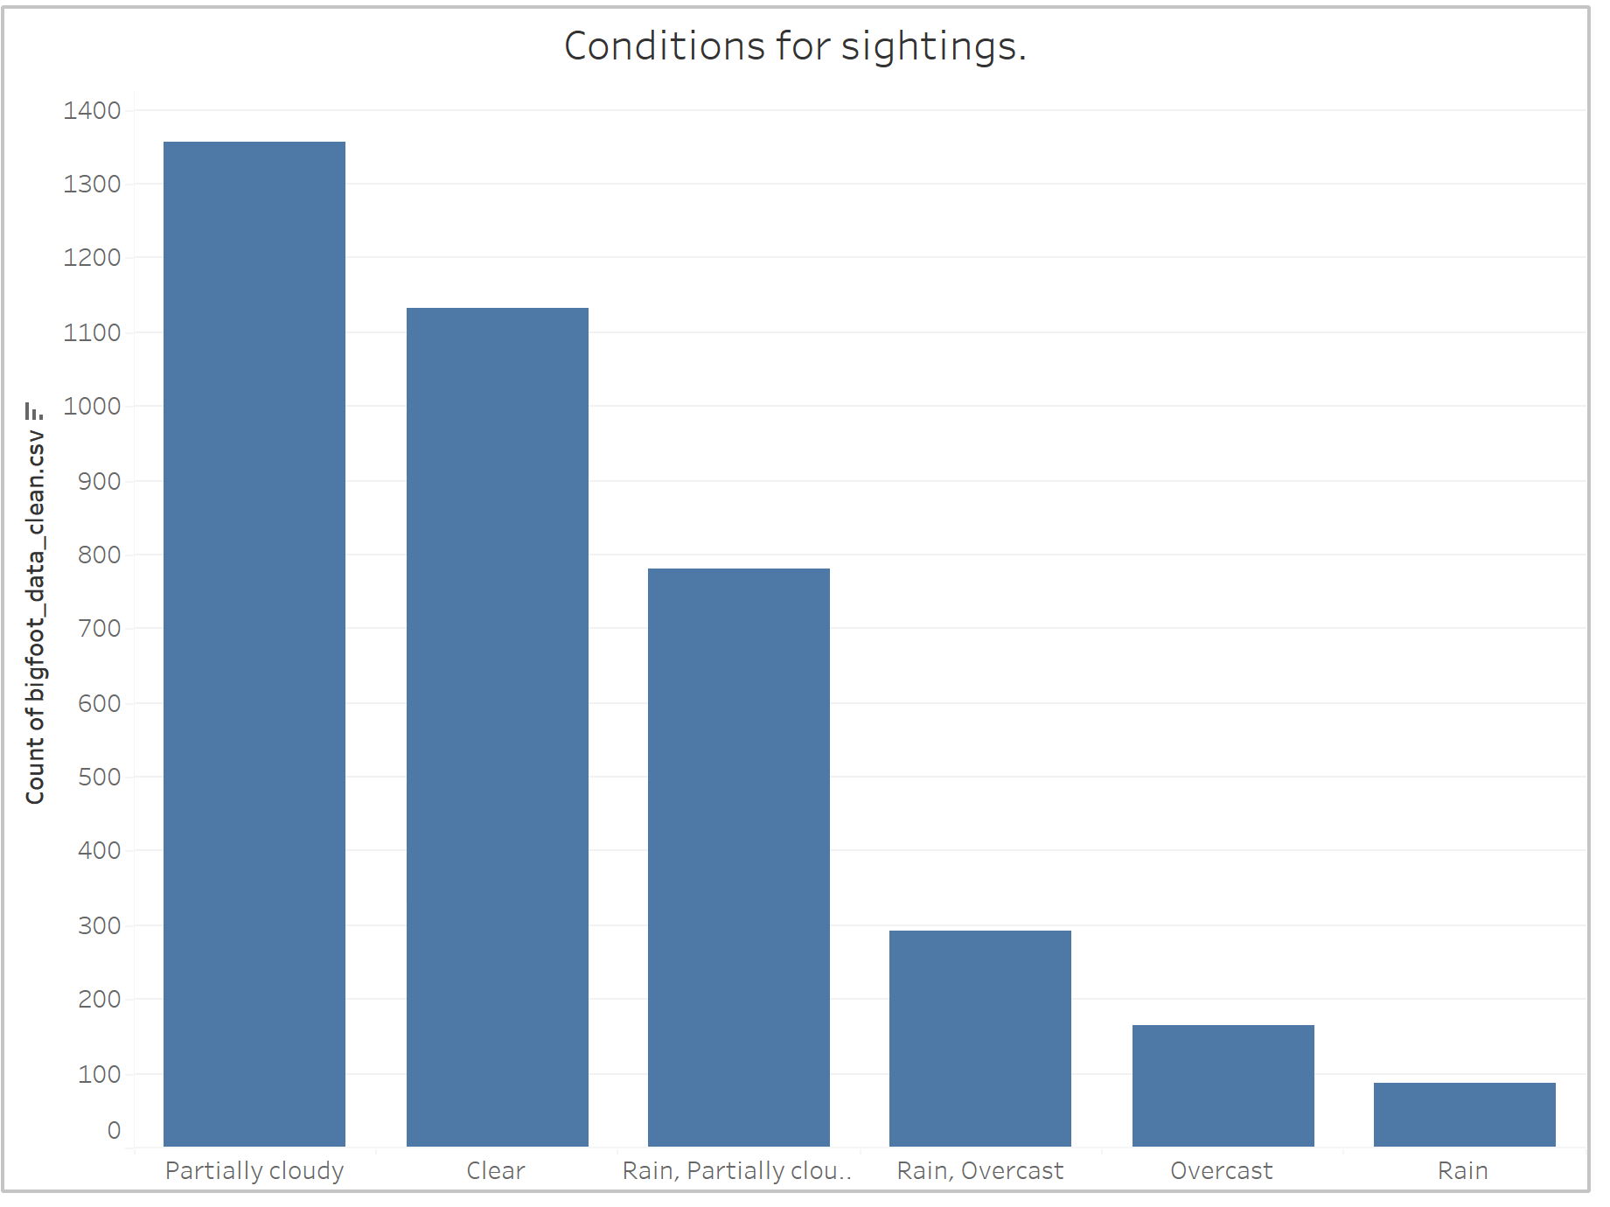
What kind of weather does he like?
It seems ol’ Mr. Foot likes partially cloudy days and clear days the most. Still probably best to bring a raincoat if you’re going squachin’.

Slide 25
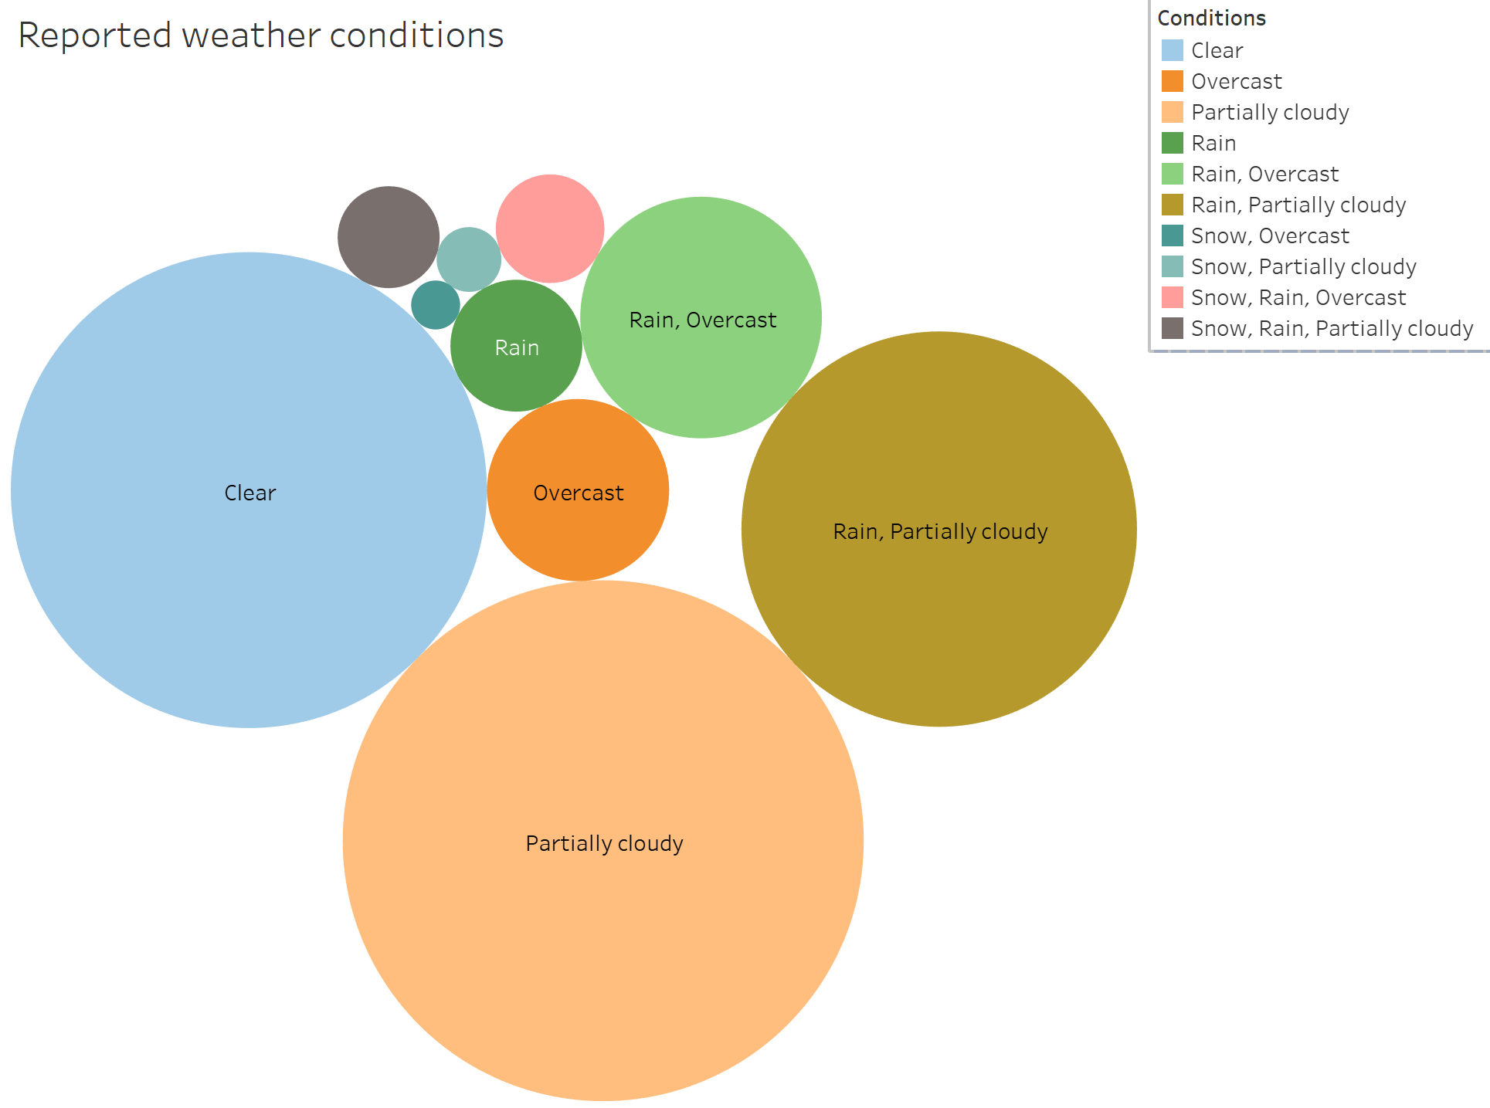
What kind of weather does he like?
It seems ol’ Mr. Foot likes partially cloudy days and clear days the most. Still probably best to bring a raincoat if you’re going squachin’.

Slide 26
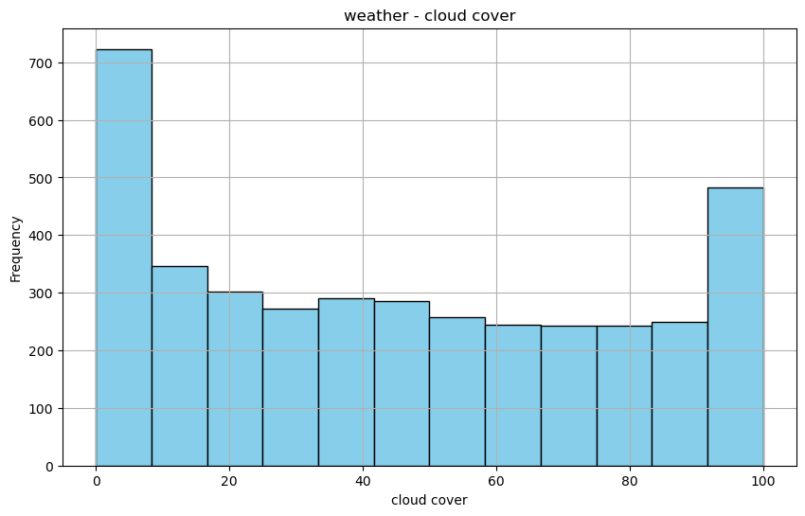
Whats that?! Up in the clouds?
The sightings seem to be weighted towards no cover and fully cloudy. This is interesting because this weather data was pulled from historical NOAA data, so users guessing falls away as a potential explanation.

Slide 27
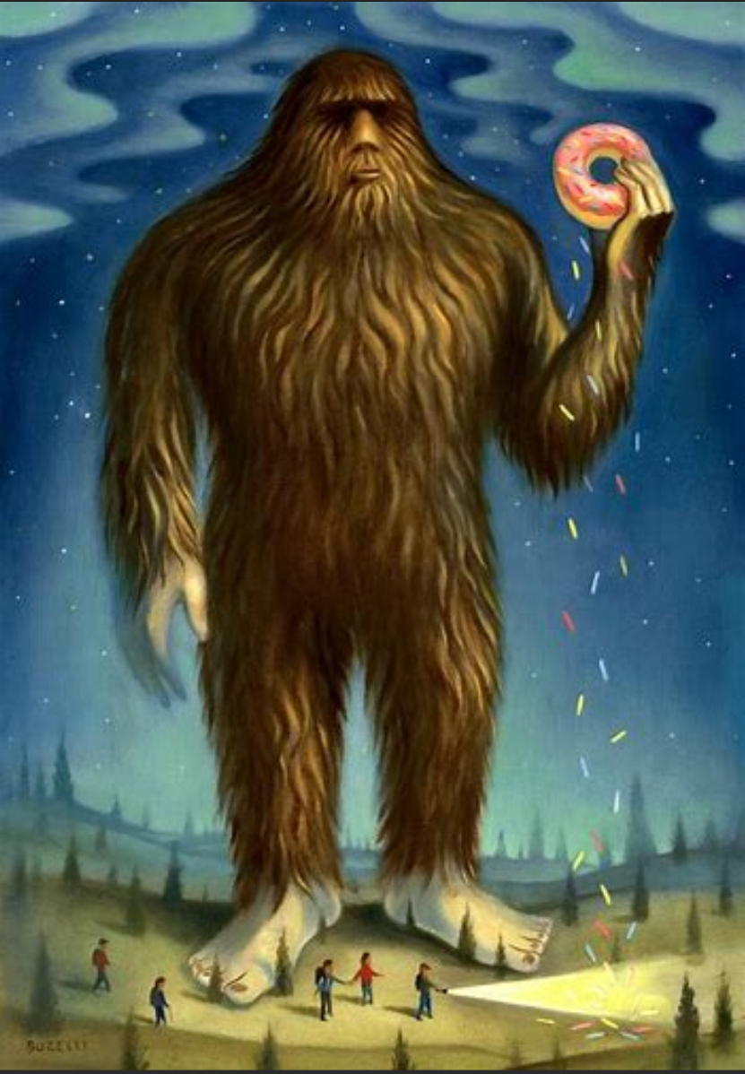
Weather conditions and Prevalence of Sightings
Here is an interactive map made in Tableau that allows you to explore different combinations of weather conditions and their effect on the number of sightings by state.

Slide 28
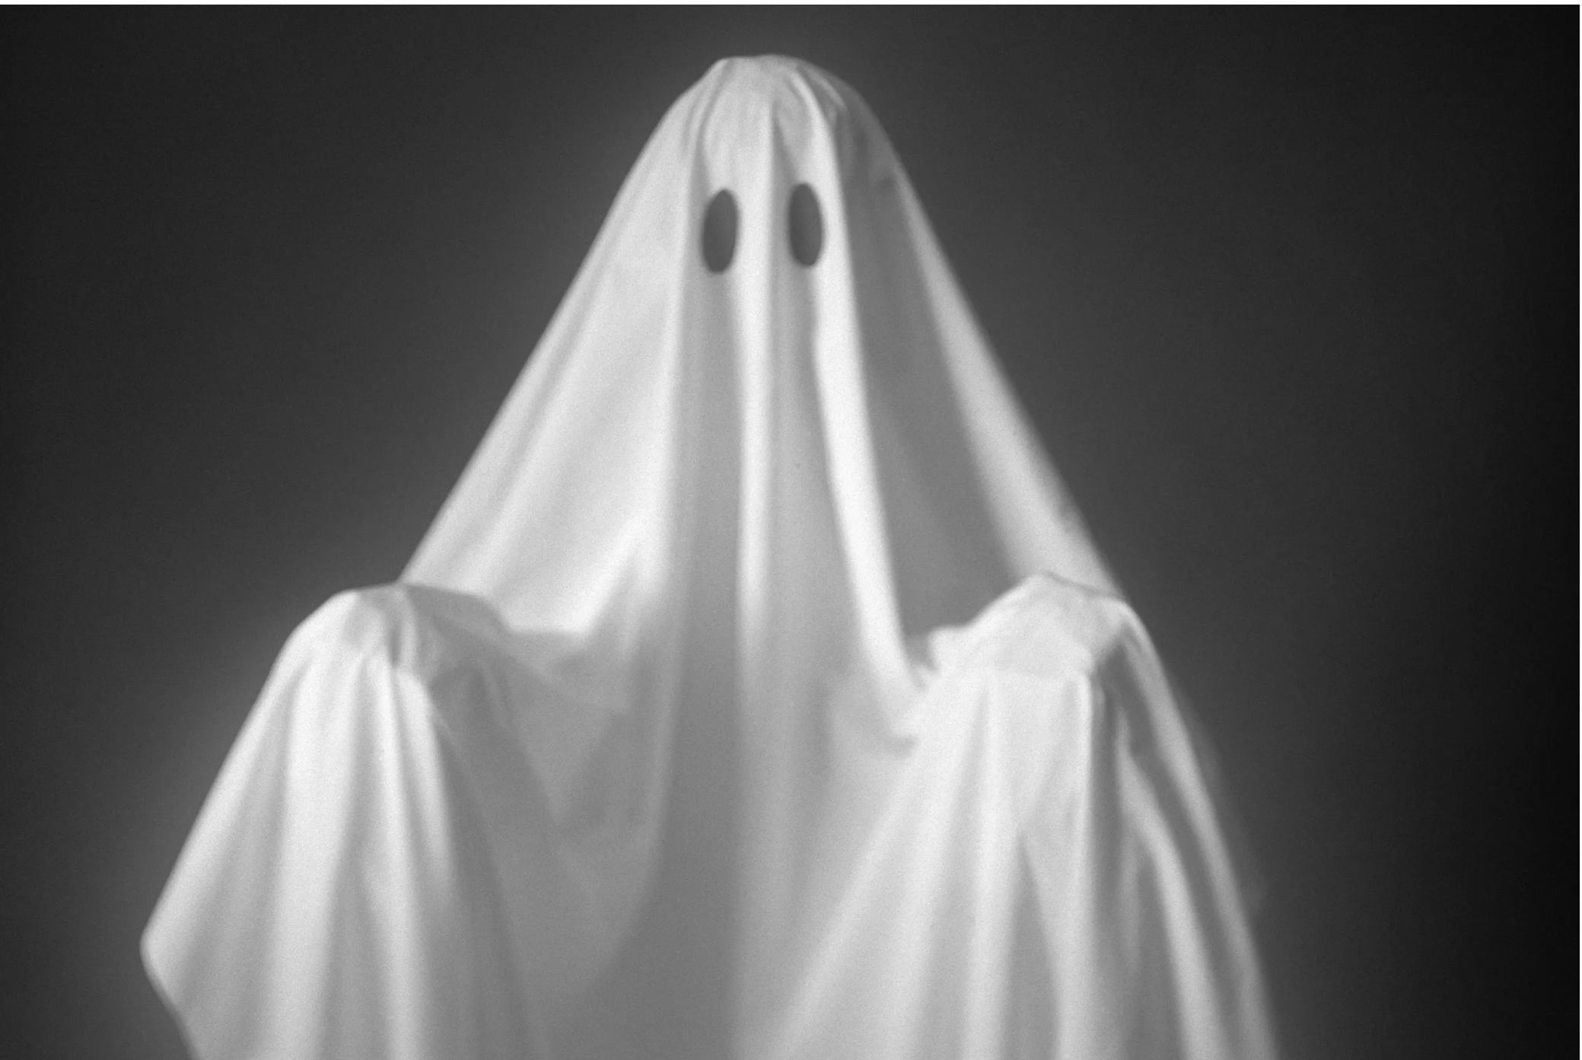
And I would have gotten away with it, If it weren’t for you meddling kids!
Where can you go to get your spook on?
The shadowlands haunted places registry reports about 11,000 haunted sights, complete with descriptions of the nature of each haunting. Including small towns, it appears you can’t go outside without finding a ghost!

Slide 29
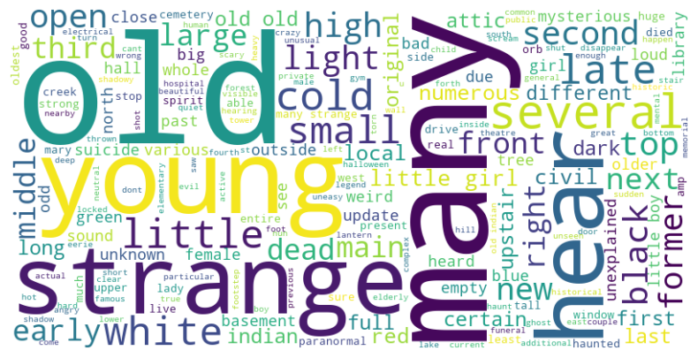
What are people saying about those ghosts?
These are the most common adjectives and descriptive words occurring the in the descriptions of the haunted places described in the shadowlands database. Standard parts of speech have been omitted.

Slide 30
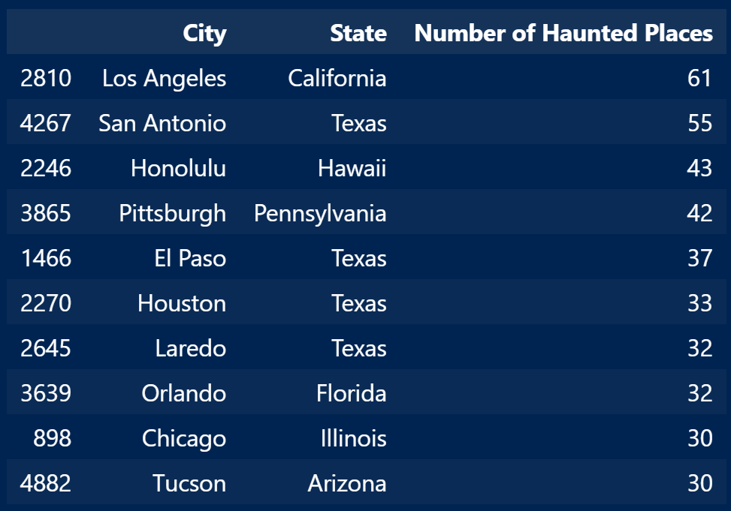
Top 10 Cities for Number of Hauntings
Please note that given the number of haunted places reported in small towns, that there are likely clusters of haunted places around cities that are not captured, as you can see these are major cities and population centers.
(This chart will be updated and made more pretty. Bear with me!)

Slide 31
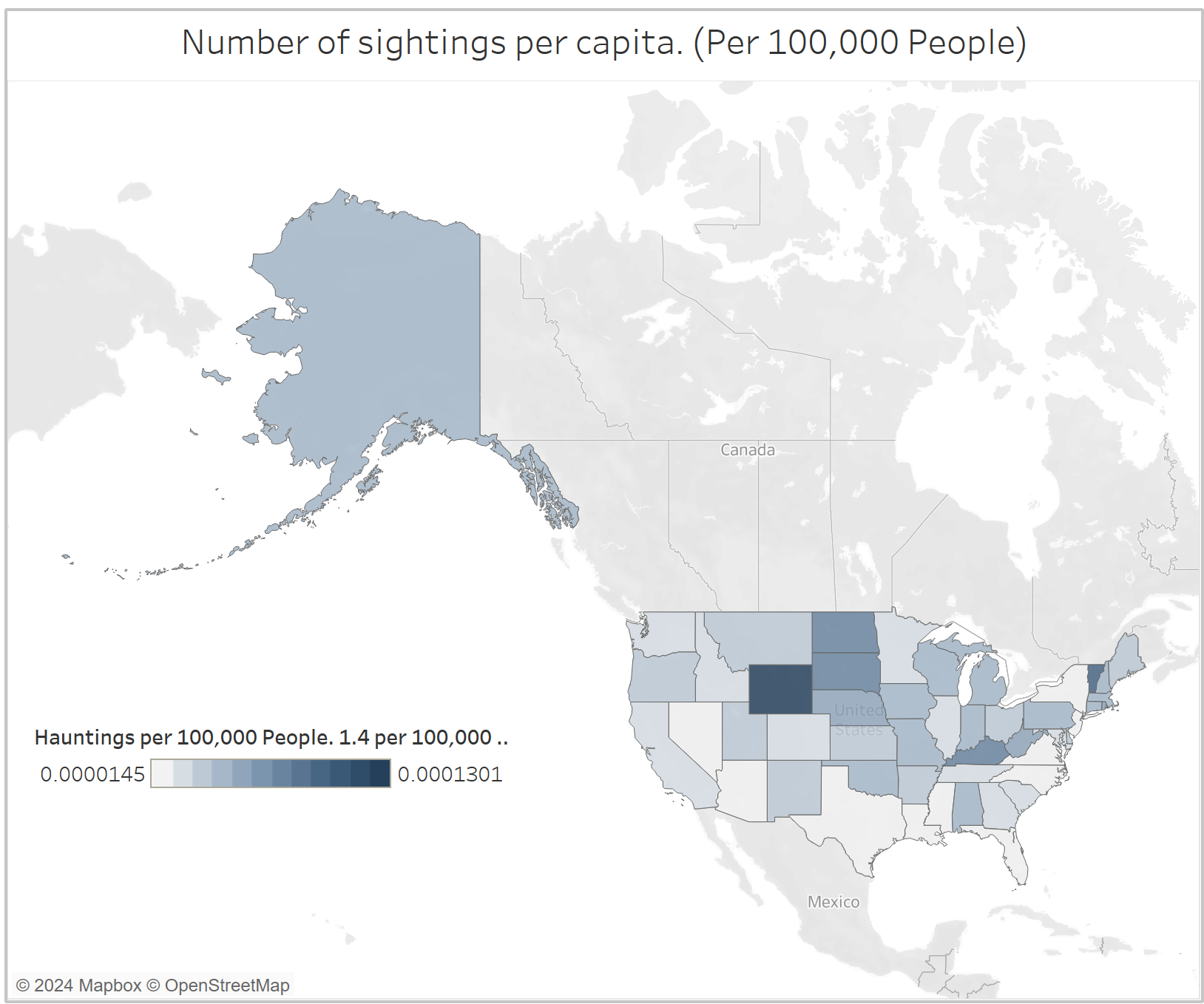
Hauntings per capita
Please note that the scale goes from 1.4 hauntings per 100,000 people to 1.3 hauntings per 10,000 people.

Slide 32
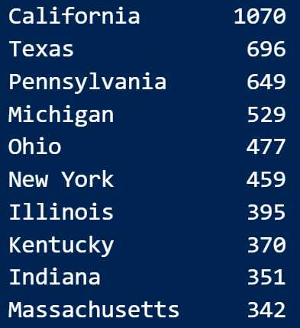
Top states by number of haunted places
This is not normalized per capita, since the haunted places are static structures or area, and not necessarily a passing phenomenon.

Slide 33
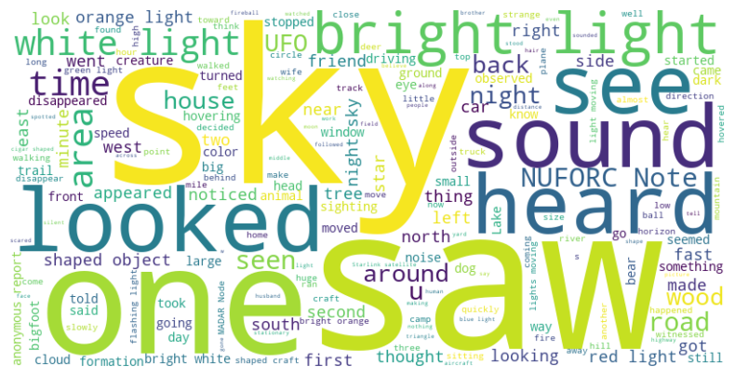
What about Commonalities between bigfoot and ufo sightings?
These are the most common adjectives and descriptive words occurring the in the descriptions of the UFO and bigfoot sightings Standard parts of speech have been omitted.
(Not sure why saw and see are counted. Will be fixed)

Slide 34
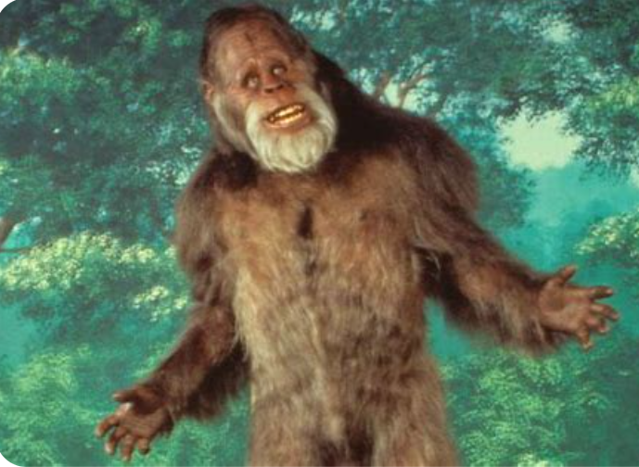
In conclusion
For bigfoot fans, we suggest travel packages to Humbolt county, California.
For UFOs, we suggest travel packages to Phoenix, AZ, over New York, due to light pollution differences.
For ghost lovers, we recommend packages to LA, or San Antonio.

